Slide 1
Forecasting CO₂ Emissions Using Machine Learning
Supporting SDG 13: Climate Action

Slide 2

SDG Problem – Climate Action
Sustainable Development Goal 13: Take urgent action to combat climate change and its impacts.
Problem Statement
Rising CO₂ emissions are driving global warming.
Industrialization and population growth worsen the problem.
Data-driven forecasting is needed to support climate policies.
Goal
Use machine learning to predict CO₂ emission trends and guide sustainable decision-making.

Slide 3
Machine Learning Approach
Type: Supervised Learning (Regression)
Models Used:
Linear Regression (Baseline)
Random Forest Regressor (Advanced Non-linear Model)
Key Features:
Year
Population (2022)
Previous Year Emissions
Tools & Libraries:
Python (Pandas, Numpy, Scikit-learn, Matplotlib)

Slide 4

Dataset Overview
Dataset: CO₂ Emissions by Country (1750–2022) Source: Kaggle
Sample Columns:
Country
Year
CO₂ Emission (Tons)
Population
Area
Data Insight:
Over 270 years of emission data.
Includes both developed and developing countries.

Slide 5
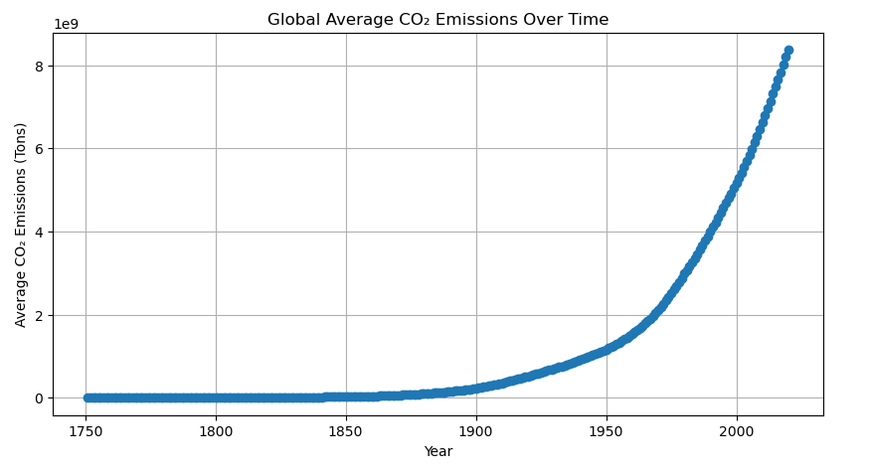
Results & Visualizations
Model Evaluation:
Random Forest R² Score: 1.000
Mean Absolute Error: 12,887,382.283
Findings:
Global CO₂ emissions rising sharply since 1950s.
Kenya’s emissions are low but increasing with urbanization.
Random Forest performed better than Linear Regression.
Visualizations:
Global Emission Trend
Top 10 Emitting Countries
Kenya: Actual vs Predicted Emissions

Slide 6
Conclusion
CO₂ emission forecasting supports SDG 13 – Climate Action.
Machine Learning offers accurate, data-driven insights.
Random Forest model predicts emission trends effectively.
Promotes sustainable policy planning and global awareness.
“Small data actions lead to big climate impacts.”

